Slide 1

MSc Business Analytics, AUEB
2019
Twitter US Airline Sentiment
Analyze how travelers in February 2015 expressed their feelings on Twitter
Presented by
Dagre Adriani
Gialama Niovi
Kondyli Afroditi

Slide 2

Outline
Motivation
Problem & Mission
Data
Explanatory Analysis
Cleaning Phase Methodology
Models
- RNNs
- CNNs
Conclusions

Slide 3

Motivation
Companies started paying close attention to the voice of customers in order to enhance the customer experience
Collecting and analyzing customer’s feedback and comments coming from social media about companies themselves, services and products, provides them the advantage to have better information in order to make strategic decisions, while having an accurate understanding of what the customer actually wants and, as a result, a better experience for everyone.
For this reason, more and more companies deploy sentiment analysis in social media platforms in order to understand what customers like or dislike about the products/services they offer.

Slide 4


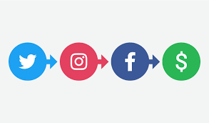
Problem & Mission
Companies have to be ready to handle streams of data coming from social media
The Problem : The vast amount of messages they receive or referred through all the social media platforms
Our Mission: Build a model that receives Twitter comments and predicts the tweet’s writer’s sentiment: positive, neutral or negative about the company and/or the providing services
Who are we: BI services providers appointed by United Airlines in order to an accurate classifier model for all tweets that refer to the company and/or its main rivals.
What’s the Benefit for the company:
extract the appropriate information, so that in the future can predict and prevent any crisis in the Airline sector,
design and accomplish to-the-point strategic moves,
improve customer ‘s experience and gain better knowledge about their competitors in the Airline sector.

Slide 5

Data
Tweets were scraped from Twitter in February 2015 about each major US Airline.
Dataset: “Twitter US Airline Sentiment” (from Kaggle as .csv)
14,640 rows and 15 columns including:
tweet id,
sentiment,
sentiment confidence score,
negative reason,
negative reason confidence,
airline,
sentiment gold,
name,
retweet count,
tweet text,
tweet coordinates,
time of tweet,
date of tweet,
tweet location,
user time zone.
Preprocessing was needed in order to gain the best results.
The stages of this preprocessing were the following:

Slide 6
Cleaning 2:
Cleaning 3:
Cleaning 4:
Cleaning 1:
Cleaning 4:
Remove
URLs
Remove
Convert to
Lower case
Tokenization
+
Stop words
+
Noooope Noope
Remove
@user
''!()-[]{};:'"\,<>./?@#$%^&*_~'

Slide 7
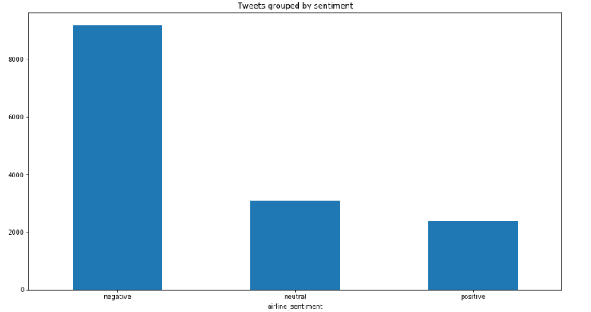
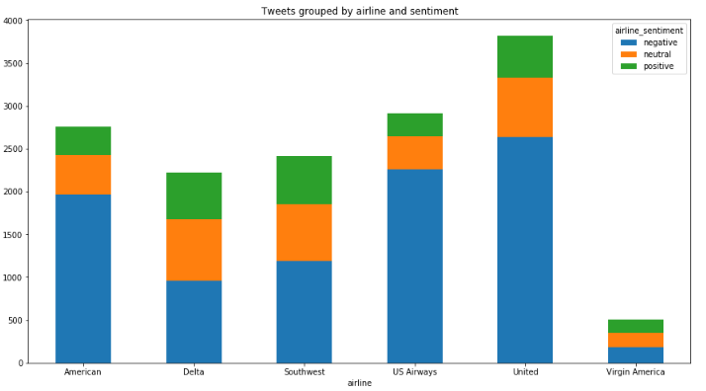
Exploratory Analysis

Slide 8

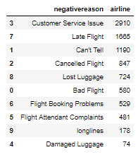
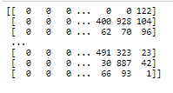
Common reasons for negative comments
The form of our data that fed the model

Slide 9
Convolution Neural Networks (CNNs)
Model Inputs
MAX_WORDS = 6000
TOKENIZETION :
Finally, each words is represented by integers based on vocabulary
Compile
Plots
A
B
C
D
E
ZERO PADDING
SPLIT DATASET :
TRAIN :80% (11712,40)
TEST : 20% (2928,40)
** VALIDATION: use the test data
Train
and
Predictions
Build CNN Model

Slide 10
B
Build the CNN Model
Embedding Layer
From scratch
Manage lower dimension
INPUT : 45 X 6000*
*Top most common words to consider
OUTPUT : 45 X 32
Convolution Layer
1DConv -> strides Vertically
Apply 64 filters 2 x 32
Output 40 x 64
Max Pooling
Take the Max Value from each filter pixel
Output 64 x 1
Dropout
Avoid overfitting
20 % in our case
3 Neurons
Softmax Function
Dense Layer
Give a probability to each sentiment

Slide 11
c
Compiling The Model
Adam ()
Multiclass Problem Categorical_crossentropy
Accuracy Better interpretation
OPTIMIZER
Optimal Weigths
LOSS FUNCTION
Deviation from actual Y values
METRICS

Slide 12
D
X_Train, encoded_Y
X_test, encoded_Y_test
Train CNN Model
+
Make
Predictions
5 epochs
Batch size = 100 tweets
- The best validation accuracy: 79.23 % &
- The minimum loss function: 52.88%
X_Test, Y_Test
Accuracy : 77.9%

Slide 13
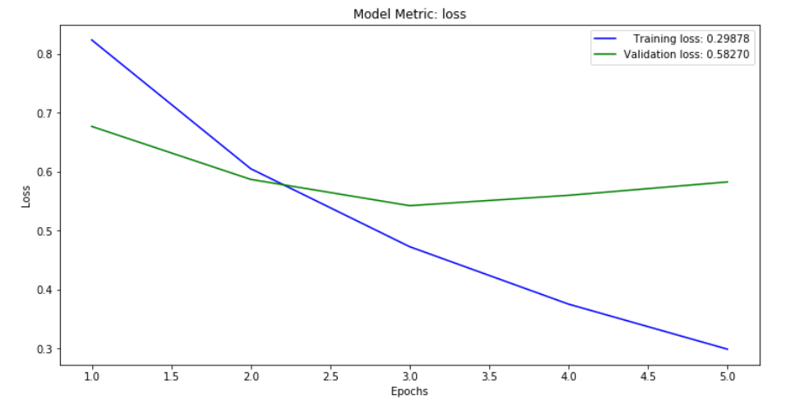
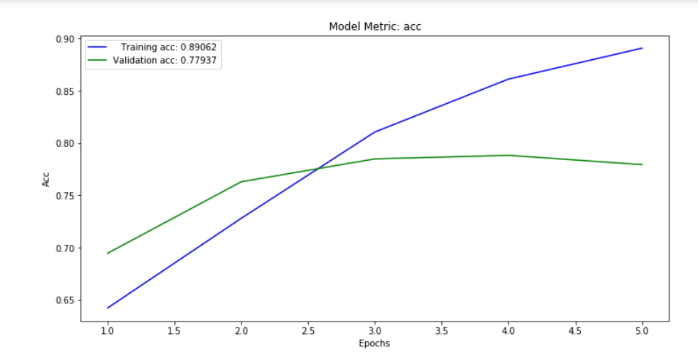
E
Plots
Eliminate epochs to 3 and Make a New model :
128 filters 3 x 32
Smaller accuracy

Slide 14
RNN Model – Data preprocessing
01
We used regular expressions to remove certain words.
02
We converted all letters to lowercase.
Example:
The airline name at the beginning of each tweet, any URL in the tweet body, symbols and single letters or numbers.
03
We removed all common words that do not have any significant semantic meaning.
04
We conducted lemmatization, which is the transformation of each word into a lemma.
Example:
“of”, “over”, “than” etc.
Example:
“Playint” -> Play
“Plays” -> Play
”Played” -> Play
“Am”, “are”, “is” -> be
“Car”, “cars”, “car’s”, "cars’” -> car

Slide 15
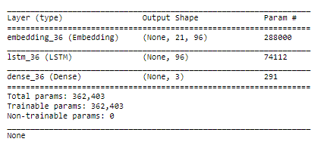
RNN Model – Model description
01
Embedding Layer
02
LSTM (Long Short-Term Memory) layer
A transformation layer used to turn the indexes we provide into dense vectors of fixed size. The embedding space we chose had 96 dimensions, because, this value gave us the better results by using a trial and error technique.
This is the heart of our RNN model. It has 96 memory units and some dropout values to avoid overfitting.
03
Dense Layer
A layer used to change the dimensions of our vector from 96 to just 3, as many as our label categories are.

Slide 16
RNN Model – Input, Loss Function, Optimizer
1. Input
We divided our data into training, validation and testing groups. The ratio we used is 68% : 7% : 25%.
Input
2. Loss Function
We used Multi-Class cross entropy (Keras: categorical crossentropy) function as it fits better multiclass problems such as ours.
Loss Function
Optimizer
3. Optimizer
We used Adagrad optimizer by using try and error technique. It gave us the better accuracy on the validation set.

Slide 17
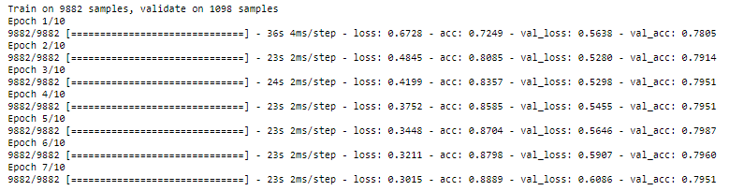
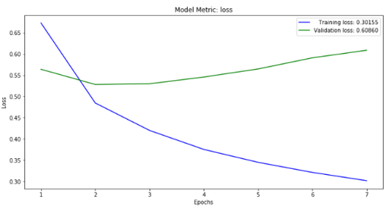
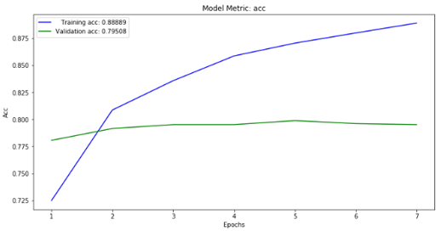
RNN Model - Results
10 epochs
trigger when two consecutive validation accuracy values are below the maximum value
maximum value we get on the validation set is 79.87%

Slide 18

Conclusions
Accuracy CNN vs RNN : 77.9% vs 77.5 %
CNN filters find a specific pattern in a tweet
BUT
Fail if there are not words connected with sentiment analysis
SO
Keep RNN to capture the important information for the right classification

Slide 19


